Slide 1
Task B - 3
AE4B33OSS, 2013
Michal Stanke
stankmic@fel.cvut.cz

Slide 2
- What should it do? -
In specified directory (and subdirs) find files with given name extension* and:
copy them with another given extension or
rename them - change their extension to another given or
just remove them.

Slide 3
- And how can it be used? -
suffix_handle.sh [ -c | -m | -r ] ext1 ext2
-c for copy,
-m for rename and
-r for remove
ext1 and ext2 are the desired extensions, where ext2 is not required by -r.

Slide 4
- What output can it produce? -
For copy and rename a list of files changed (before => after).
For remove a list of files removed.
And some error output... (nobody's perfect)

Slide 5
- Let's code it -
Check –v and –h parameters
„Parse&check“:
directory (read permissions)
operation parameter
extension parameters
Process the files

Slide 6
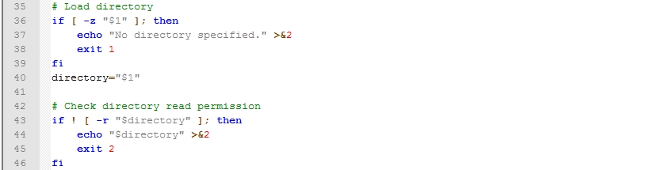
- Parse the first argument -
Which is the directory.

Slide 7
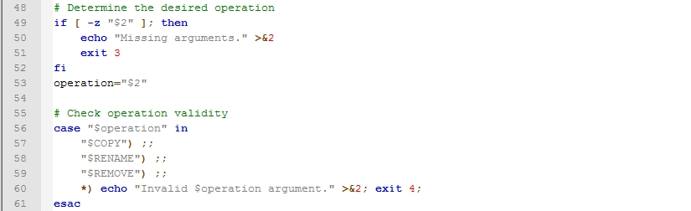
- Second argument -
Desired operation – just validate it.

Slide 8
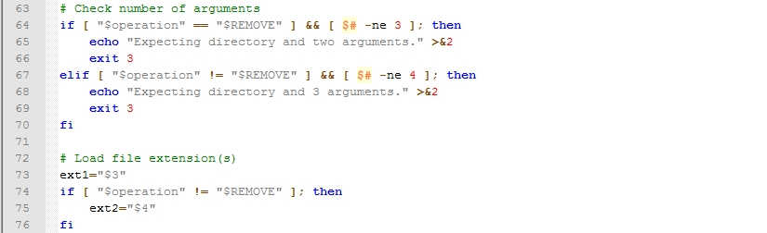
- Third and maybe fourth arg -
Check arg number according to the operation.

Slide 9
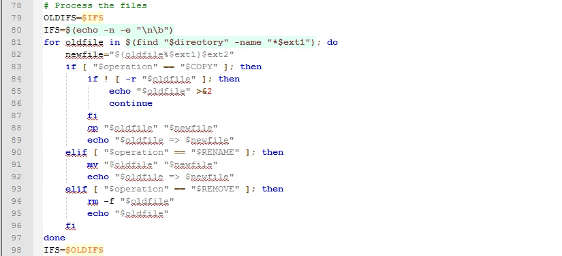
- Process the files (THIS IS IT) -
Finally make the desired operation.

Slide 10
- 100 ! (feel like a champion) -
☺

